Slide 1
EPA Source Apportionment Spring 2026 Capstone
Deeya Datta, Prateek Mishra, & George Whittington
Client: Mike Cyterski, EPA

Slide 2
Table of contents
01
02
03
04
Recap
About our new client and the data
Time Series
Trends and temporal patterns
Clustering
Grouping observations by similarity
PCA
Finding components of variance
Notes:
Deeya Slide

Slide 3
01
Recap
Our Project Data and New Client
Notes:
Deeya Slide

Slide 4


Source Apportionment
Source apportionment is a "collection of techniques to provide information
regarding how much a source (usually a generalized category) contributes to the
overall pollutant concentration at receptor (usually a monitoring site) (Rizzo, 2010).
The overall goal is to extract latent factors from the data. We can then interpret these factors to identify specific source profiles.
Notes:
Deeya Slide
Source apportionment: We have air pollution data with a bunch of different species and their concentrations and we are trying to kind of reverse engineer and figure out what the sources are of the pollutants are. Ultimately we want to build some models that will help us create our source profiles but we have just been working on wrapping up EDA this month.

Slide 5
The Datasets
Baltimore
Baton Rouge
St. Louis
focuses on fine particulate matter (PM2.5) chemical composition (n=630)
focuses on volatile organic compounds (VOCs) rather than particulate matter (n=307)
focuses on fine particulate matter (PM2.5) chemical composition (n=418)
Notes:
Prateek Slide
We have three data sets across three cities. Baltimore and St Louis use particulate matter (PM) while Baton Rouge uses volatile organic compounds.

Slide 6
Variables Across Cities
City | Category | Count | Specific Species Included
Baltimore | Trace Elements | 17 | Al, As, Ba, Br, Ca, Cl, Cr, Cu, Fe, Mn, Ni, Pb, Se, Si, Ti, V, Zn
 | Ions | 5 | NH₄⁺, K⁺, Na⁺, SO₄²⁻, NO₃⁻
 | Carbon & Mass | 4 | EC, OC, OM, PM2.5
Baton Rouge | VOCs | 41 | BTEX, Alkanes, Alkenes & Isoprene
St. Louis | Trace Elements | 8 | Cd, Cu, Fe, Mn, Ni, Pb, Se, Zn
 | Ions | 2 | SO₄²⁻, NO₃⁻
 | Carbon & Mass | 3 | EC, OC, PM2.5
Notes:
Deeya Slide
Here is a closer look at that data we just mentioned. As you can see from this table, we're not measuring the same species in each city, and that's actually really important for our analysis.
In Baltimore, they measured 17 trace elements like aluminum, lead, zinc, and others. They also captured 5 different ions including ammonium, potassium, and sulfate, plus 6 carbon and mass measurements like elemental carbon and PM2.5 (particulate matter smaller than 2.5 micrograms). So Baltimore gives us a pretty comprehensive picture of lots of particulate matter.
Baton Rouge is pretty different. Here the data focused heavily on volatile organic compounds, or VOCs. They measured 41 different VOCs including BTEX compounds, alkanes, alkenes, and isoprene. Basically, this is a much more chemically specific dataset focused on gaseous pollutants rather than particulate matter.
St. Louis falls somewhere in between. We have 8 trace elements, only 2 ions, and 3 carbon and mass measurements. It's a smaller set overall but still gives us sufficient information to conduct PMF.
Making a note of these differences helps inform us of what kind of profiles we will probably develop in each city. For example, the presence of VOCs tips us off that we are likely picking up on things like vehicle emissions and industrial solvents, while the trace elements possibly indicate road dust and combustion.
Looking ahead, the types of source profiles we develop will look different in each city because each dataset is a unique environments.

Slide 7
02
Time Series
Temporal Patterns in the Data
Notes:
Prateek Slide

Slide 8
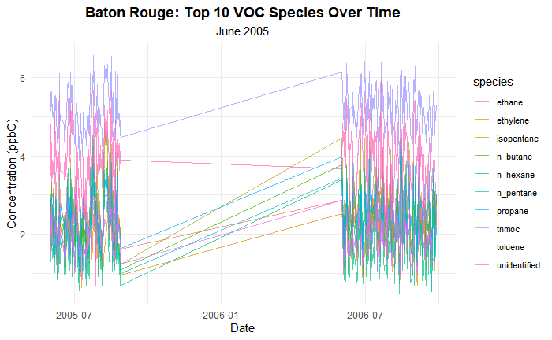
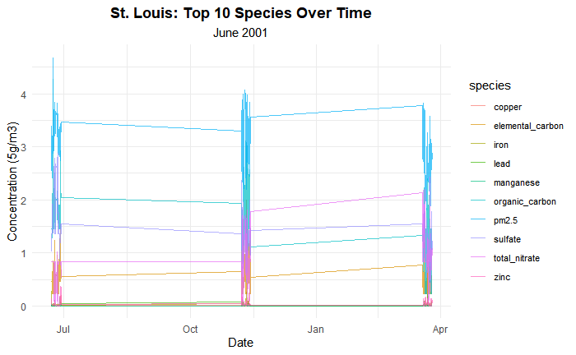
All three of our datasets had gaps in the data
Broke all of them up into more continuous chunks
Split Baton Rouge 3am and 6am
Notes:
We have a lot of data so we needed to look at each dataset big picture and address any concerns. Right off the bat all three of our datasets had gaps where we we did not have data for weeks at a time. We began by splitting the datasets up into more continuous pieces. So Baton Rouge was split into 2 pieces and then split again after we saw those chunks also had week long gaps in them. St. Louis was split into the 3 chunks you can visually see above and those 3 were pretty continuous. Since Baton Rouge data was time stamped and either collected at 3am or 6am, we also separated out the Baton Rouge data into 2 time series of data collected at 3am and 6am .

Slide 9
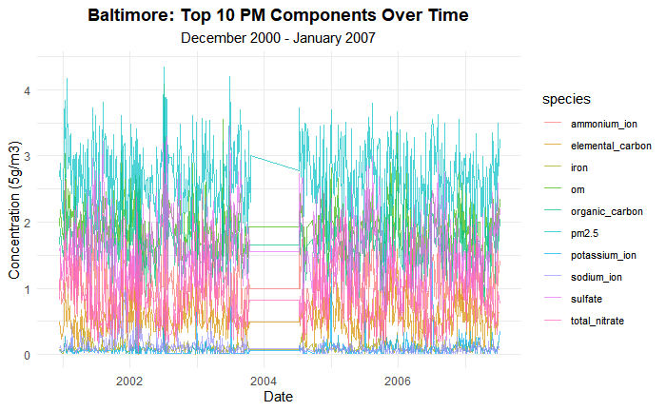
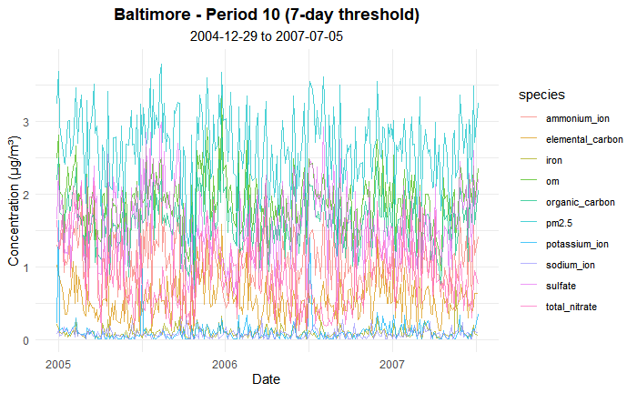
Example: Baltimore
Broke Baltimore into a total of 10 continuous periods
Period 10 was the most robust so it is our starting point for time series analysis
Notes:
Here is our third dataset, Baltimore. Baltimore is the longest spanning of our datasets so it was the one we had to break up the most. In the top left you can see the original plot that had a big gap in the middle. We split it into two and then realized that the first half had many gaps in data collection longer than 7 days, so that first left half was broken into 9 pieces. The half on the right had pretty regular data collection so we did not need to split it up further. We decided to use Period 10 as a starting point for our actual analysis since it was a section of our data that was regularly measured and had a large amount of observations.

Slide 10
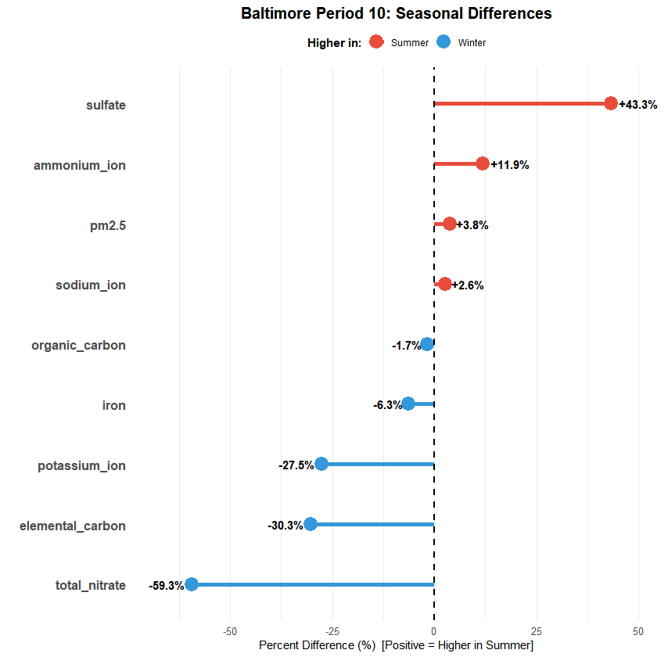
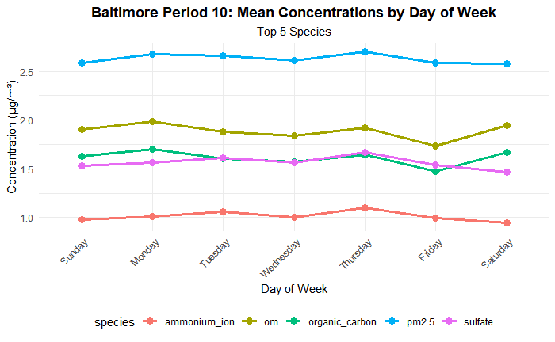
Looked at periodic trends within the period
No significant periodicity looking at days of the week
However seasonal differences were found
Notes:
We wanted to look at periodic trends within the data. One thing we were really interested in was if there was any weekday effects resulting from something like maybe traffic spiking on Mondays and bottoming out on weekends. For this data we found no significant weekly trend.
All species show flat profiles across Monday-Sunday with no weekend effect and then we also did
Statistical tests (t-tests) confirmed no significant weekday vs. weekend differences (all p > 0.12)
We did see some significant seasonal differences between winter and summer though.
We can see that in the lollipop chart on the right.
Winter: nitrate 59% higher than in summer , elemental carbon 30% higher, potassium 28% higher
Summer: sulfate 43% higher than in winter, ammonium 12% higher
Seasonal ANOVA showed highly significant differences (p < 0.0001) for all those species except ammonium p = 0.06
Iron, oc, sodium ion, pm2.5 did not have signifiant change

Slide 11
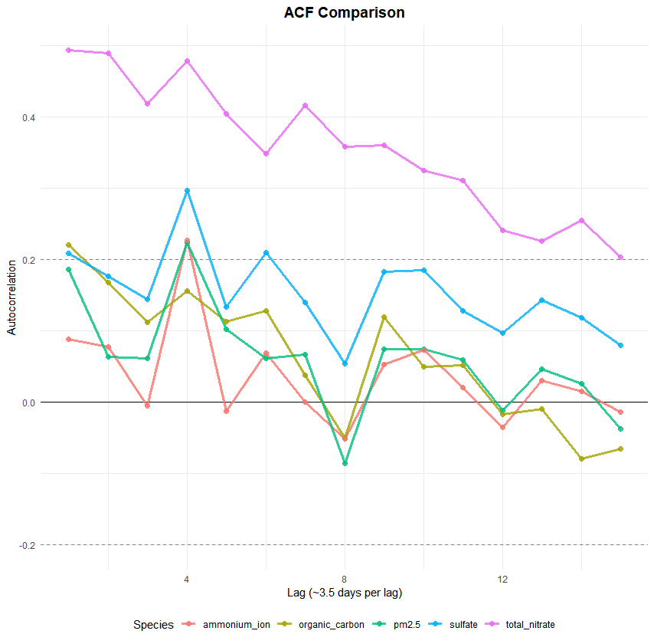
Currently working on further time series analysis
ACF and PACF
Started with top 5 species in just Period 10 of Baltimore
Will expand to some more species, then replicate with the other periods in Baltimore
Hopefully repeat a similar process with other two regions
Notes:
On the right we have the ACF plot for the top 5 species in the Baltimore Period 10 Data.
The ACF plot measures autocorrelation which is how well past values predict current values at different time lags. I have it set to 3.5 days per lag
We can see Nitrate (purple) has the longest memory, staying correlated at 10+ lags. Sulfate shows moderate 2-3 week persistence, while PM2.5, organic carbon, and ammonium lose correlation within days. Most importantly, no species shows peaks at lags 2-3 which is the one-week mark supporting our finding that there's no weekend effect
Moving forward we want to extend all this analysis to the other periods of Baltimore and then hopefully repeat the same process with the other regions to wrap up time series EDA.
Total Nitrate (Purple):
Concentrations stay strongly correlated for over a month, with values from 36+ days ago still helping predict today's levels.
Sulfate (Blue):
Shows moderate but erratic persistence, with correlations oscillating between 0.1 and 0.3 for about 2-3 weeks before fading.
PM2.5 (Teal):
Starts with weak correlation around 0.2 and smoothly declines to near-zero within 10-14 days.
Organic Carbon (Yellow):
Displays minimal correlation, dropping rapidly below 0.2 within 2-3 weeks and oscillating near zero afterward.
Ammonium Ion (Red):
Shows almost no correlation at any lag, hovering near zero throughout with no discernible pattern or persistence.

Slide 12
03
Clustering
Grouping by similarity rather than time
Notes:
George Slide

Slide 13
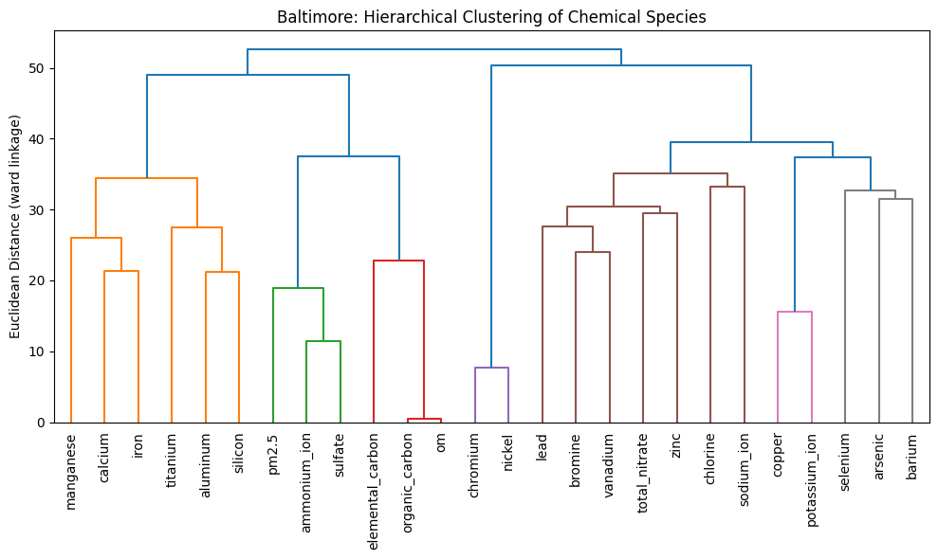
Baltimore
- Organic matter and Organic Carbon cluster at around 0 dist
- Sulfate, Ammonium cluster with PM
- Signs of secondary aerosol formation
- Chromium + Nickel form a distinct, isolated cluster.
Notes:
Data Redundancy: First, 'Organic Matter' and 'Organic Carbon' merge at near-zero distance. While they aren't chemically identical, they are statistically indistinguishable in this dataset. We removed Organic Matter to prevent collinearity issues in the model.
Secondary Aerosols: We see Sulfate and Ammonium forming a tight sub-cluster with PM2.5. This aligns with atmospheric theory, suggesting that Secondary Inorganic Aerosols—pollution formed in the atmosphere rather than emitted directly—are a major driver of total mass here.
Industrial Sources: Finally, Chromium and Nickel form a distinct pair, separate from the road dust elements. This indicates a specific industrial or metallurgical source, likely fuel-oil combustion or metal processing, distinct from general traffic."

Slide 14
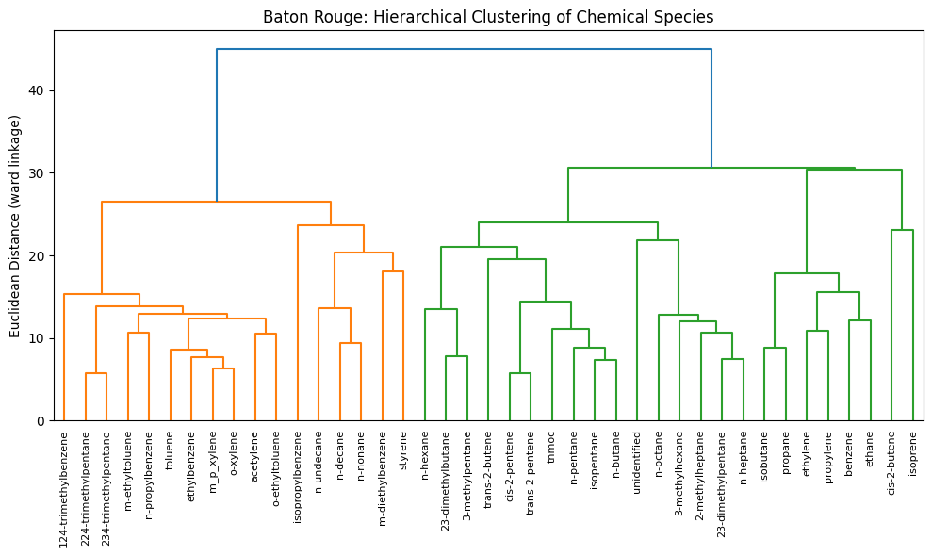
Baton Rouge
- Aromatics (Benzene, Toluene, Xylenes) cluster together, standard vehicle exhaust signature
- Light Alkanes (Ethane, Propane) form a completely separate group
- Simple model successfully distinguishes refinery/petro-
chemical leaks from car exhaust.
Notes:
The Traffic Signal: We see a grouping of aromatic hydrocarbons, including Toluene and Xylenes. These are chemically associated with traffic emissions and solvents.
The Industrial Signal: Crucially, the Light Alkanes—specifically Ethane and Propane—form a separate cluster from those aromatics.
The Takeaway: This structural separation is a strong indicator that the model can distinguish between petrochemical or natural gas signatures and standard urban traffic. It suggests we will be able to resolve these as distinct sources in the final apportionment."

Slide 15
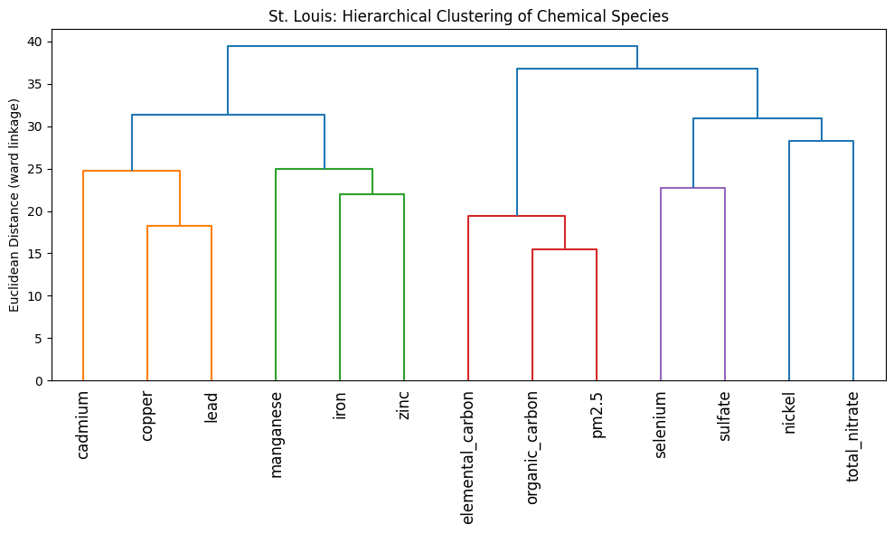
St. Louis
- Elemental Carbon + Organic Carbon cluster together
- Burning stuff is the primary driver of particle pollution event
- Sulfate groups specifically with Selenium
- Selenium is a unique tracer for coal
Notes:
The Carbon Cluster: Elemental Carbon and Organic Carbon cluster tightly together. This indicates that combustion sources are releasing these pollutants simultaneously.
The Coal Fingerprint: The most significant finding is that Sulfate groups specifically with Selenium.
Why that matters: Selenium is a known tracer for coal impurities. Finding it linked with Sulfate is consistent with the signature of regional coal-fired power plants, allowing us to differentiate regional power generation from local urban pollution.

Slide 16
04
PCA
Finding components of variance
Notes:
Prateek Slide

Slide 17
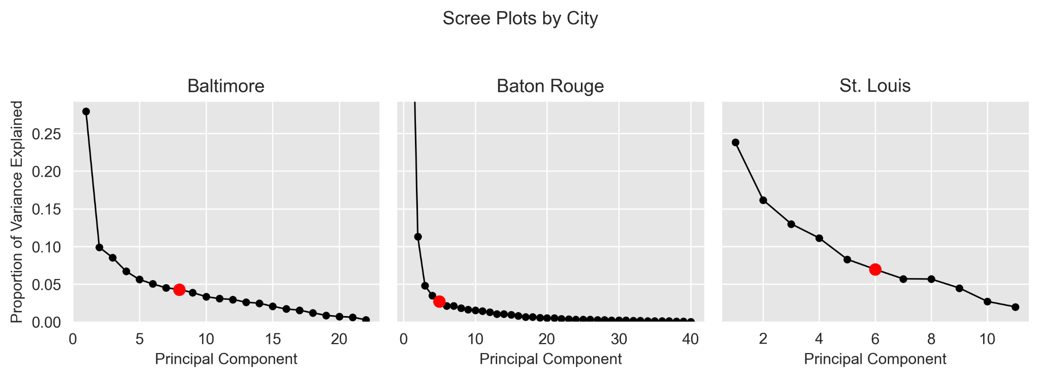
Choosing Principal Components
City | Baltimore | Baton Rouge | St Louis
Number of PCs | 8 | 5 | 6
Total Variance | 72.5% | 77.1% | 79.4%
Notes:
We fit PCA to try and find sources of variation. The scree plots show how variance is distributed across principal components for each city. Baton Rouge has a lot of PCs which suggests there are multiple distinct sources of variability compared to St louis which has fewer components and a steeper decline.
Because of the number of PCs, we used a cumulative variance threshold of 70-80% instead of the elbow method giving us 8 PCs for baltimore, 5 for baton rouge, and 6 for st louis

Slide 18
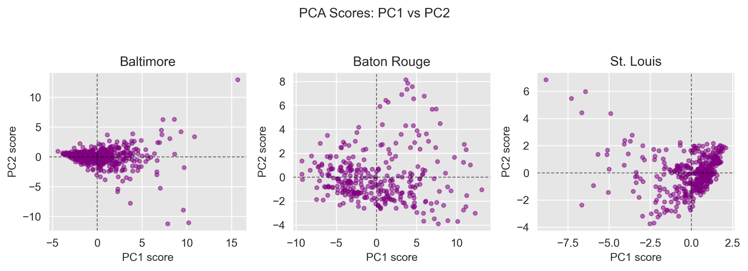
PC1 vs PC2
Score distributions along the first two principal components, with Baton Rouge exhibiting greater dispersion in the PC1–PC2 space.
Notes:
This figure shows the observations in a PC1 PC2 space. Baton Rouge exhibits the greatest spread, indicating substantially higher variability captured by the first two components while St louis and Baltimore form more compact clusters showing the dominant variability is more constrained among the first two components. Using this we can look at the factor loadings in a new perspective.

Slide 19
PC1 Factor
City | Dominant Contributors | Interpretation
Baltimore | Fe, OC, Br (+); Na⁺, Ba, Ni (–) | Contrast between combustion metals (Fe, OC, Br) and marine influenced species (Na⁺, Ba, Ni)
Baton Rouge | TMPs, n-Heptane, DMPs (+); Isoprene, light alkenes (–) | Industrial fuel VOCs (TMPs, n-Heptane) contrasted with biogenic hydrocarbons (Isoprene, alkenes)
St Louis | SO₄²⁻, Se, Ni (+); Pb, Zn, Fe (–) | Contrast between sulfate and trace metals (SO₄²⁻, Se, Ni) from primary metals (Pb, Zn, Fe)
This shows us covariance that guides factor selection and structure
Notes:
This slide summarizes the first principal component, which captures the dominant covariance structure in each city. Some factor loadings are positive and negative which shows groups of chemical species that increase and decrease with others.
In Baltimore, PC1 separates combustion metals and from marine species, suggesting a contrast between urban emissions and coastal influence. This makes sense location wise.
In Baton Rouge, PC1 is driven by industrial fuel VOCs contrasted with biogenic hydrocarbons. This points to strong industrial versus natural emission dynamics.
And in St. Louis, PC1 contrasts trace metals with primary metal emissions.
Here only PC1 is shown but we can look at the factor loadings for other PCs as well to get more information.
The covariance structure tells us how many factors we expect and how we can potentially interpret them in the source apportionment model

Slide 20
Thanks!
Do you have any questions?

